Slide 1
Webservices
History

Slide 2
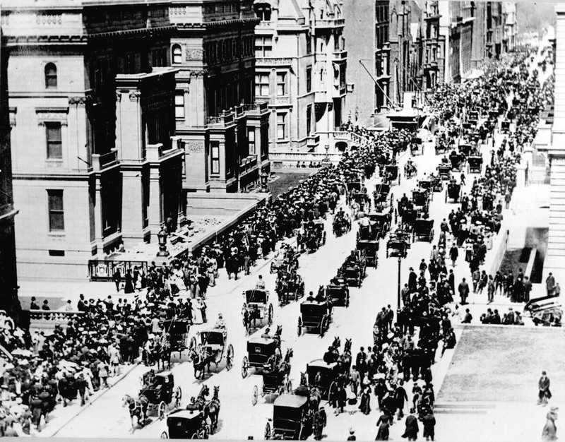

Slide 3
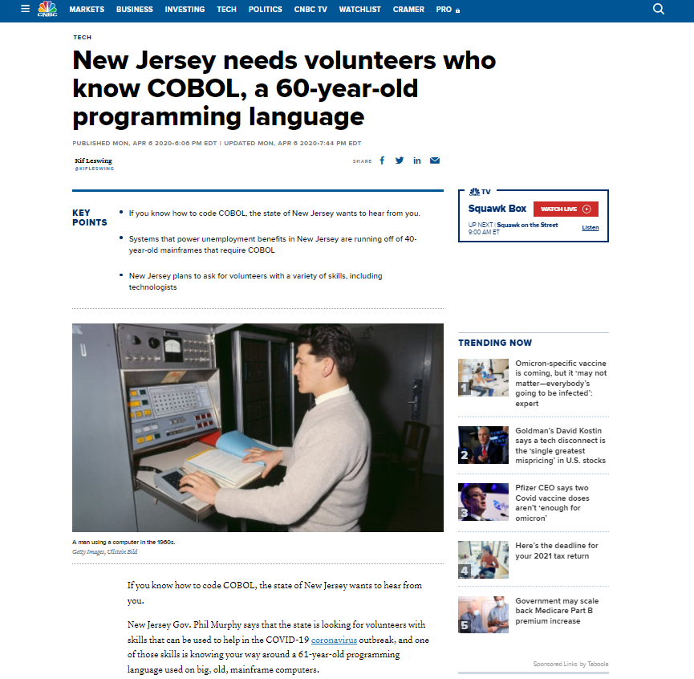

Slide 4
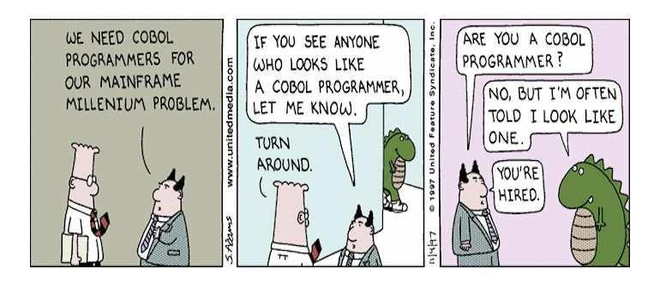

Slide 5
COMPONENT ARCHITECTURES
A component architecture is a method of designing software components
The components should be easily connected together, reused, or replaced
Without re-compiling the application that uses them.
A Component, is a piece of software that:
Is like a library, rather than a stand-alone application
Is distributed in a compiled, executable form
Exposes a group of methods and properties to its client application

Slide 6
Historical approaches
CORBA (OMG)
DCOM (Microsoft)
XPCOM (Mozilla)
RMI (Sun Microsystems) on JRMP/IIOP

Slide 7
COMPUTER

Slide 8
COMPUTER
SOFTWARE

Slide 9
COMPUTER
SOFTWARE-1
SOFTWARE-2

Slide 10
COMPUTER & OS
SOFTWARE-1
SOFTWARE-2

Slide 11
COMPUTER & OS
SOFTWARE-1
Component-A
Component-B
SOFTWARE-2
Component-C
Component-B

Slide 12
COMPUTER & OS
SOFTWARE-1
Component-A
Component-B
SOFTWARE-2
Component-C

Slide 13
COMPUTER & OS
SOME OTHER COMPUTER
SOFTWARE-1
SOFTWARE
Component-A
Component-B
Stub
Component-B Implementation
NETWORK
AND
OTHER ORB/COM INFRA
SOFTWARE-2
Component-C
Component-B
Stub
DESCRIBE
DISCOVER
COMMUNICATE

Slide 14

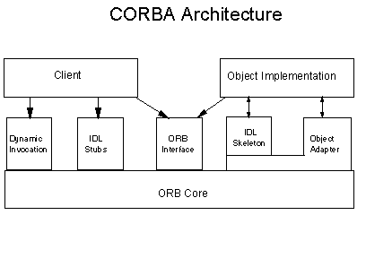
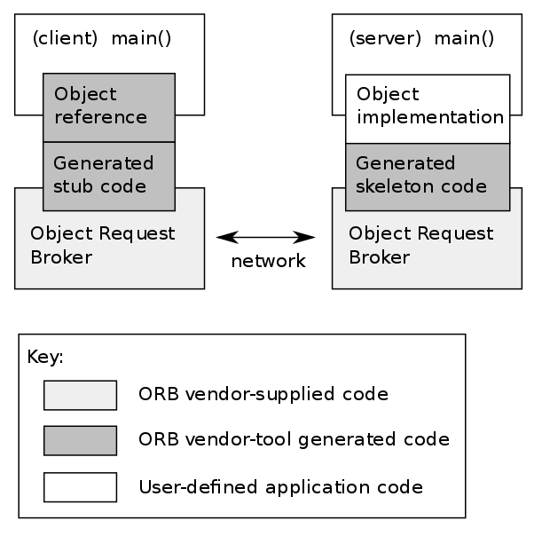
CORBA
CORBA (OMG) It is standards-based, vendor-neutral, and language-agnostic. Very powerful but limited however by its complicated way of utilizing the power and flexibility of the Internet.

Slide 15

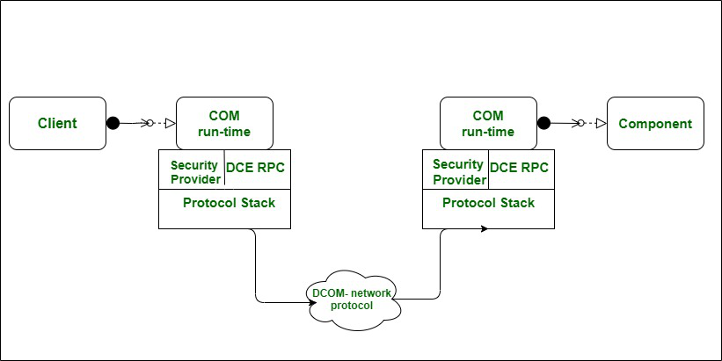
DCOM
DCOM (Microsoft) Distributed Computing platform closely tied to Microsoft component efforts such as OLE, COM and ActiveX.

Slide 16

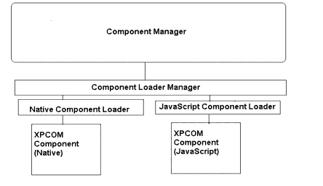
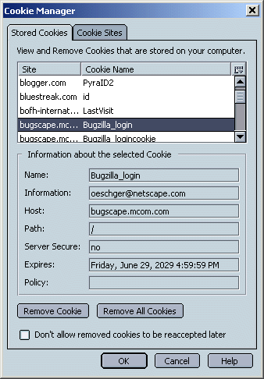
XPCOM
XPCOM is a Mozilla made competitor to DCOM (Microsoft). Stands for Cross.

Slide 17

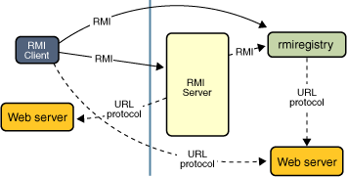
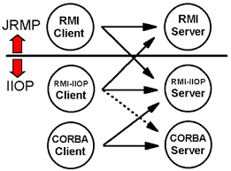
Java - RMI
Java RMI provides the mechanism by which the server and the client communicate and pass information back and forth. This build a distributed object application.
The RMI over IIOP implementation supports interop with CORBA

Slide 18
Historical approaches (More to READ)
IDL: https://www.omg.org/spec/IDL/About-IDL/
Example: http://jmvidal.cse.sc.edu/csce590/spring02/corba-idl-intro.pdf
DCOM (Microsoft) :
(COM) https://www.cs.umd.edu/~pugh/com/
https://condor.depaul.edu/elliott/513/projects-archive/DS420Fall98/Edinburgh/dcom.htm
XPCOM (Mozilla) : https://developer.mozilla.org/en-US/docs/Mozilla/Tech/XPCOM
CORBA (OMG) It is standards-based, vendor-neutral, and language-agnostic. Very powerful but limited however by its complicated way of utilizing the power and flexibility of the Internet. : https://www.omg.org/spec/CORBA/About-CORBA/
RMI (Sun Microsystems) https://docs.oracle.com/javase/tutorial/rmi/overview.html
Web Services (W3C) Web services are more of an evolution than a revolution

Slide 19
What is a WEBService?
Definition: A Web Service is a standards-based, language-agnostic software entity, that accepts specially formatted requests from other software entities on remote machines via vendor and transport neutral communication protocols, producing application specific responses.
Standards based - W3C, etc
Language agnostic - Any programming language
Formatted requests - XML, JSON, EDN, BSON etc
Remote machines – Over the network (web)
Vendor neutral – No one vendor controls the standards or specifications
Transport neutral – HTTP, SMTP, ??
Application specific responses – Business-aware responses

Slide 20
Benefits of Webservices
Loosely Coupled
Each service exists independently of the other services that make up the application.
Individual pieces of the application to be modified without impacting unrelated areas.
Ease of Integration
Data is isolated between applications creating ’silos’.
Web Services act as glue between these and enable easier communications within and across organisations.
Service Reuse
Takes code-reuse a step further and reduces duplication
(Theoretically) A specific function within the domain is only ever coded once and used over and over again by consuming applications.

Slide 21
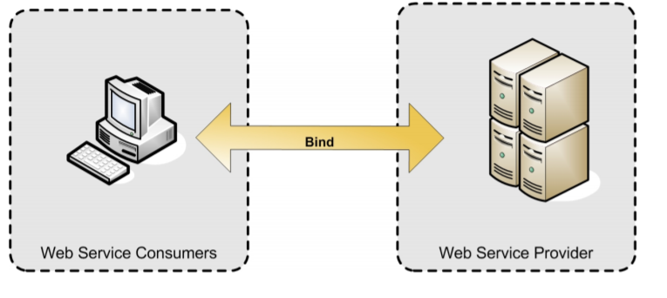
Webservices architecture (simple)
The simplest Web service system has two participants:
A service producer (provider)
A service consumer (requester).
The provider presents the interface and implementation of the service
The requester uses the Web service.

Slide 22
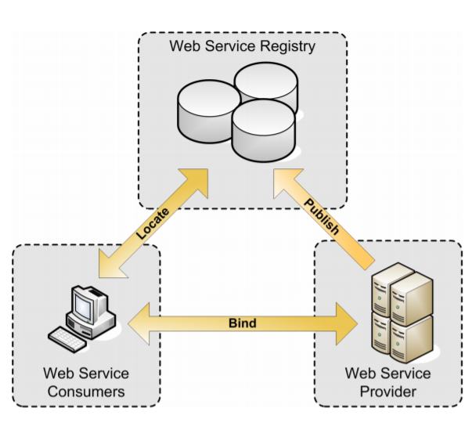
Webservices architecture (COMPLEX)
A registry, acts as a broker for Web services.
A provider, can publish services to the registry
A consumer, can then discover services in the registry and start using it.

Slide 23
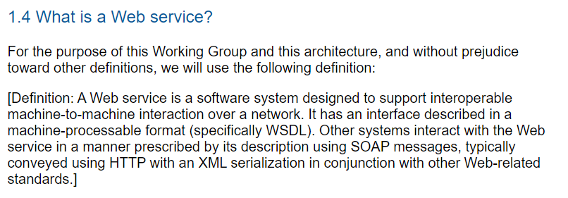
WEBSERVICES (Decade OLD DEFINITION)
https://www.w3.org/TR/ws-arch/#technology

Slide 24
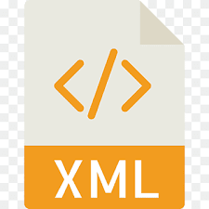
Webservices
DEFINITION (WSDL)
DISCOVERY (UDDI)
COMMUNICATION (SOAP over HTTP)
All focuses on a vendor-neutral widely agreed upon message-exchange format

Slide 25
What is XML?
XML is a software- and hardware-independent tool for storing and transporting data.
XML stands for eXtensible Markup Language
XML is a markup language much like HTML
XML was designed to store and transport data
XML was designed to be self-descriptive
XML is a W3C Recommendation

Slide 26
XML COMPONENTS
Elements
The pairing of a start tag and an end tag.
Attributes
A name-value pair that is part of a starting tag of an Element.
Processing Instructions
Special directives to the application that will process the XML document.
Comments
Messages helping a human reader understand the source code.
Character
Data Characters (in a specific encoding) Entities Whitespace

Slide 27
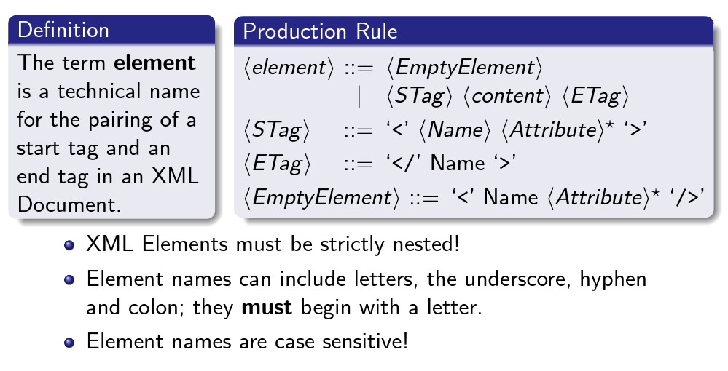

Slide 28
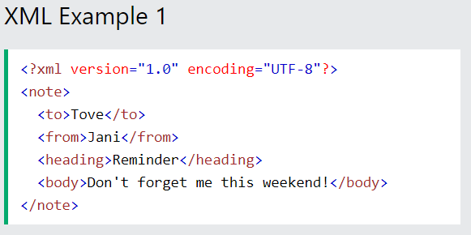
XML example
show real XML
Elements
Processing tags
Etc
W3Schools

Slide 29
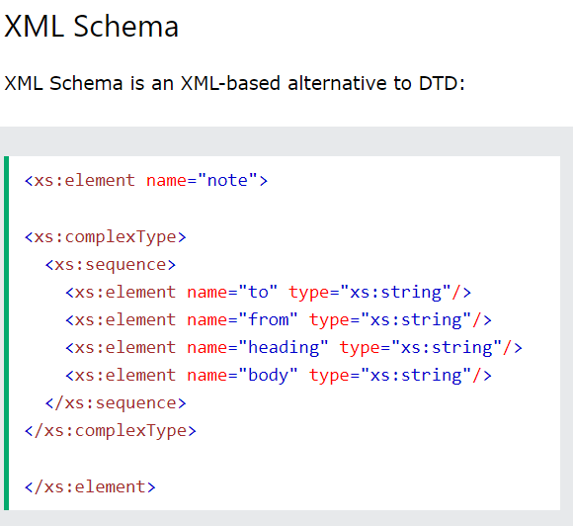
SOME problems and FIXes
Physical Structure of the document
Well formedness (Parsers)
Logical Structure of the document
Validity (Schemas). Semantics of the elements?
Element Name clashes between Documents
Namespaces
Lets see examples……

Slide 30
Tutorial EXERCISE – XML & SCHEMA
Use the question assigned to you in FSD-2 Lab Exam
Create a Schema for Storing the data as XML (XSD File)
Create an XML document as an example and validate using the schema
Turn in the following
XSD file
XML file
Screenshot of validation

Slide 31
SOAP AND WSDL WEBSERVICES
The Classical!

Slide 32
SIMPLE OBJECT ACCESS PROTOCOL
SOAP is an industry accepted W3C specification for a ubiquitous XML distributed computing infrastructure.
A mechanism for defining the unit of communication.
A mechanism for error handling.
An extensibility mechanism Lives above the transport layer of OSI
Simply put its a mechanism that allows the transmission of XML documents, regardless of transport layer protocol.

Slide 33
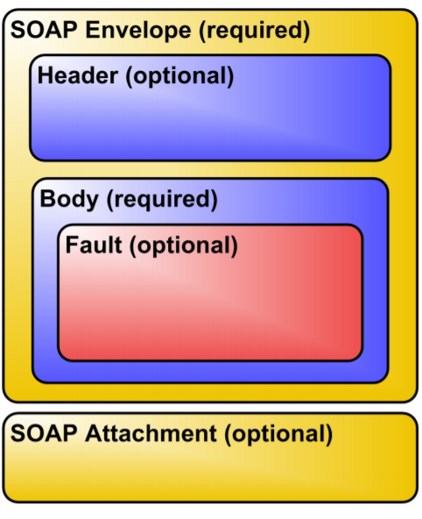
STRUCTURE OF SOAP MESSAGES
The root element of a SOAP message is the Envelope element.
It contains an optional Header element and the required Body
Elements called Faults can be used to describe exceptional situations.
It can contain optional Attachments in MIME encoding for exchanging binary data.

Slide 34
SOAP MESSAGES
Lets see some examples!
W3Schools

Slide 35
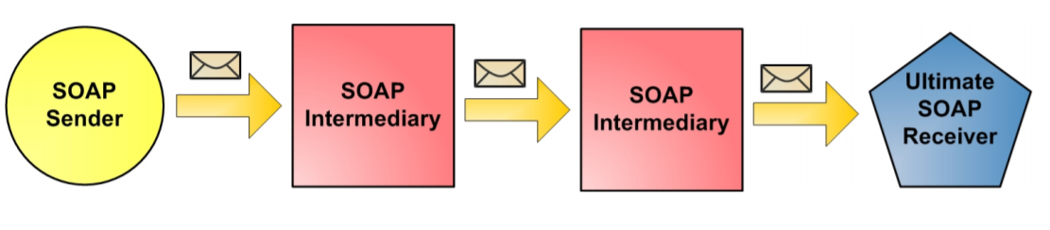
SOAP MESSAGE DELIVERY
The SOAP Sender creates and sends a SOAP Message to an ultimate SOAP Receiver.
One or more optional SOAP Intermediaries can be positioned to intercept messages between the the sender and the receiver. They can perform filtering, logging, catching etc.
The SOAP sender’s intended destination is called the Ultimate SOAP Receiver.

Slide 36
WEB SERVICES DEFINITION LANGUAGE
Web Services Description Language (WSDL) is an XML format for describing all the information needed to invoke and communicate with a Web Service.
It gives the answers to the questions Who? What? Where? Why? How?
A service description has two major components:
Functional Description
Defines details of how the Web Service is invoked, where it’s invoked.
Focuses on the details of the syntax of the message and how to configure the network protocols to deliver the message.
Nonfunctional Description
Provides other details that are secondary to the message (such as security policy) but instruct the requestor’s runtime environment to include additional SOAP headers.

Slide 37
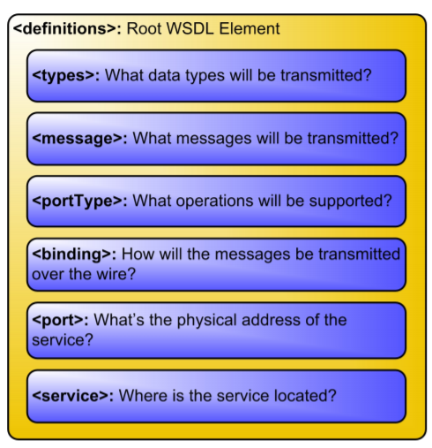
WSDL STRUCTURE
A WSDL Document is a set of definitions with a single root element. Services can be defined using the following XML elements:
Types, think Data Type
Message, think Methods
PortType, think Interfaces
Binding, think Encoding Scheme
Port, think URL
Service, many URLs

Slide 38
WSDL EXAMPLE
Let’s see some real examples!
W3Schools

Slide 39
GENERAL ARCHITECTURE OF WEBSERVICES
Request/
Response
SERVICE CLIENT
SERVICE SERVER
Communication Channel / Transport (ex: HTTP, SMTP)

Slide 40
GENERAL ARCHITECTURE OF WEBSERVICES
SERVICE DEFINITION DOCUMENT
URL
Service calls and signatures
Accepted message format
Transport
Request/
Response
SERVICE CLIENT
SERVICE SERVER
Communication Channel / Transport (ex: HTTP, SMTP)

Slide 41
TYPICAL WSDL SOAP WEBSERVICES
WSDL
SOAP
SERVICE CLIENT
SERVICE SERVER
HTTP

Slide 42
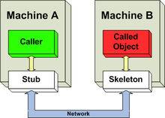
WSDL COMMON USAGE
Auto Created
Auto Created

Slide 43
Lets see a live example!

Slide 44
PROBLEMS WITH WSDL-SOAP
XML can become very verbose
So there is a tradeoff between bandwidth, data transfer, etc
Primarily for heavy duty work
Can transfer binary data through attachments
XML is designed for machine readability
Tedious to debug
Even though tools are available
You don’t need
A supercomputer for browsing facebook
A written contract and registrar for borrowing 10 Rs from a friend
The necessity of webservices have become widespread
Unlike earlier we can imagine using webservices even for simpler things
The advent of smartphones have exacerbated this

Slide 45
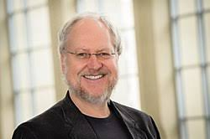
REST TO THE RESCUE
Piggybacks on HTTP verbs (we will soon see how)
JSON format though not directly connected to REST, it goes hand-in-hand with the proliferation of RESTFul services
JSON is a pleasure to deal with (Thanks Doug Crockford)
(read) Javascript the good parts
Cons
No machine readable definitions (at least till a while back)
Remember I am old!
Hence, No auto stub generation tools
But we don’t need them anyway
because its simple

Slide 46
Reference
Slide Outlines thanks to : https://www.cl.cam.ac.uk/~ib249/teaching/Lecture1.handout.pdf

